Slide 1

Hierarchical processing underpins competition in tactile perceptual bistability
Farzaneh Darki
PI: James Rankin
College of Engineering, Mathematics and Physical Sciences
University of Exeter
ISRC CN3 Autumn school
October 2022
Email: F.Darki2@exeter.ac.uk

Slide 2
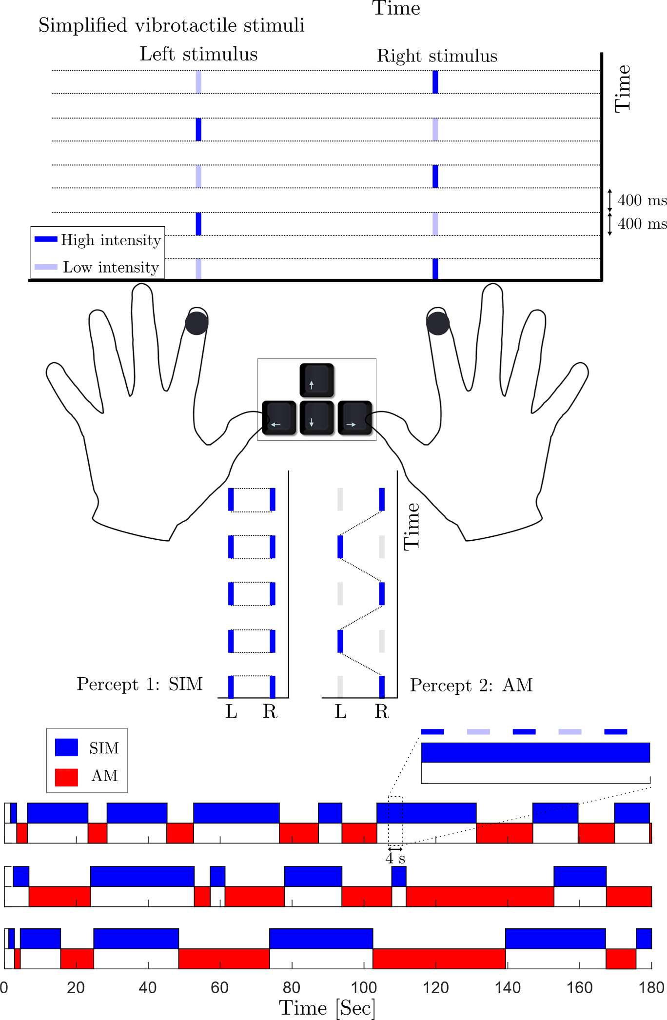
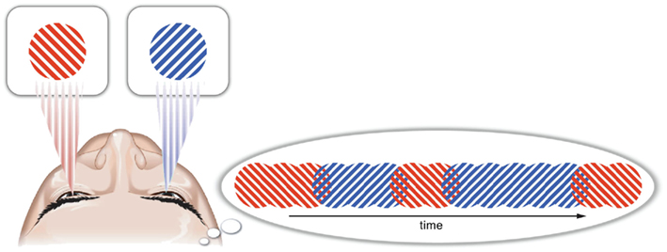
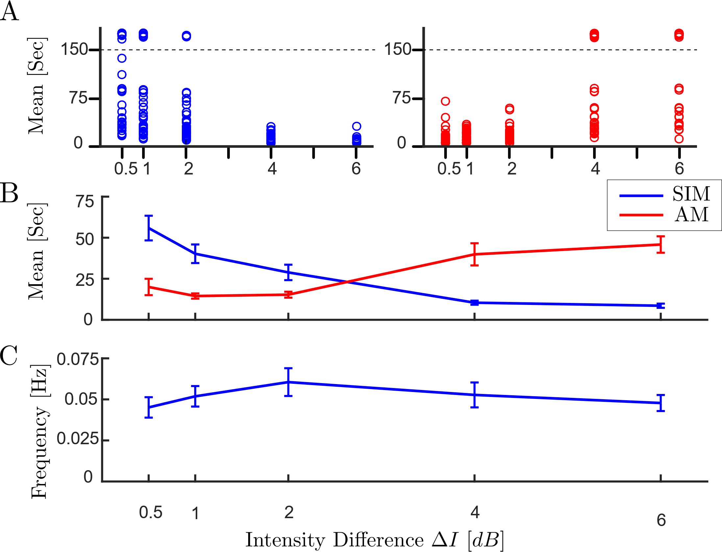
Perceptual competition
Perceptual competition
Binocular rivalry
Tactile rivalry stimuli
Percept types:
SIM
AM
Levelt’s proposition II
Darki, Rankin, Attention, Perception, & Psychophysics 2021
1/3
Notes:
I also carried out some behavioural experiments. So in this work I introduced a simple vibrotactile stimulus, which is capable of generating perceptual rivalry and explored whether general features of perceptual rivalry from other modalities extend to the tactile domain.
Antiphase sequences of high and low intensity vibratory pulses delivered to the right and left index fingers, Participants reported their perception of the stimuli by pressing the arrow keys on a keyboard. Two different perceptual interpretations can arise that compete for dominance over time, SIM stands for Simultaneous vibrations in both hands, and AM stands for apparent motion, where participant feels the vibration moves backwards and forwards between fingers.
I varied Intensity difference between the high and low vibratory pulses as a control parameter during different trials. And wants to assess its effect on perceptual durations. Looking at mean perceptual dominance we see that Increasing intensity difference (ΔI ) causes the mean dominance of SIM percept to decrease and AM percept to increase, and the frequency of alternations peaks at an equiponderance point.
This is well-known as Levelt’s proposition’s 2 in perceptual rivalry. Beside Levelt’s proposition, I also showed that other characteristics of sensory bistability that generalize in vision and auditory sensation extend to the tactile modality.

Slide 3
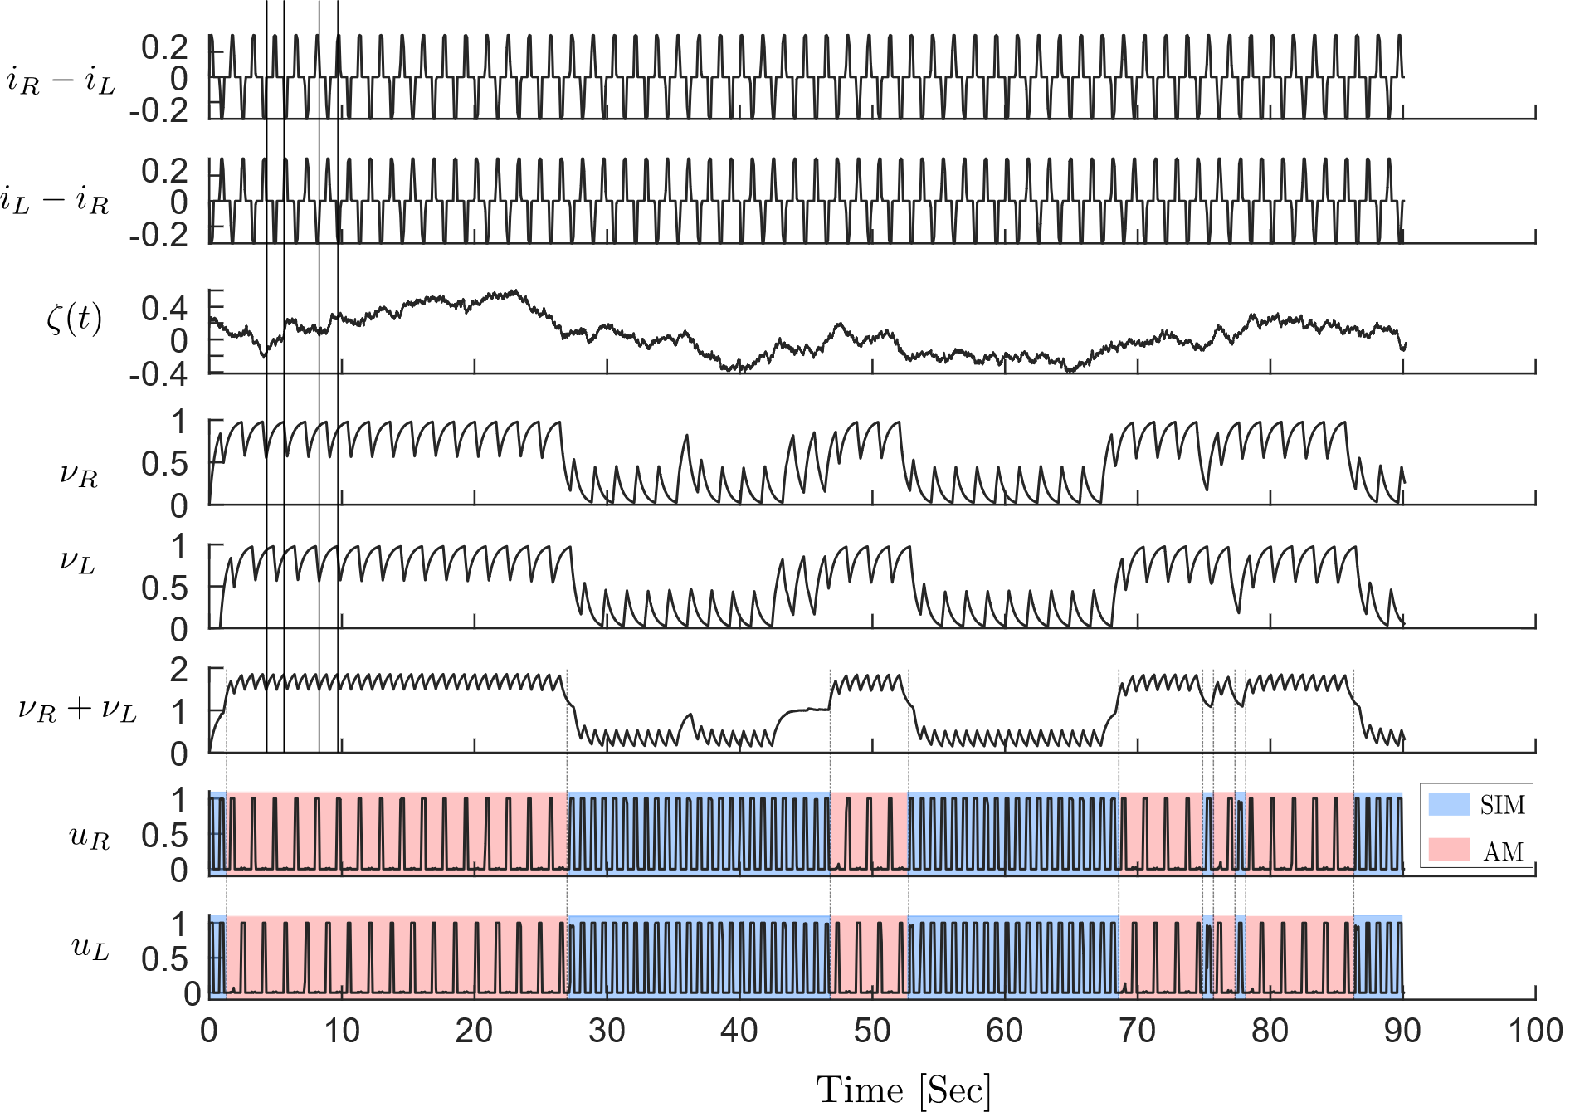
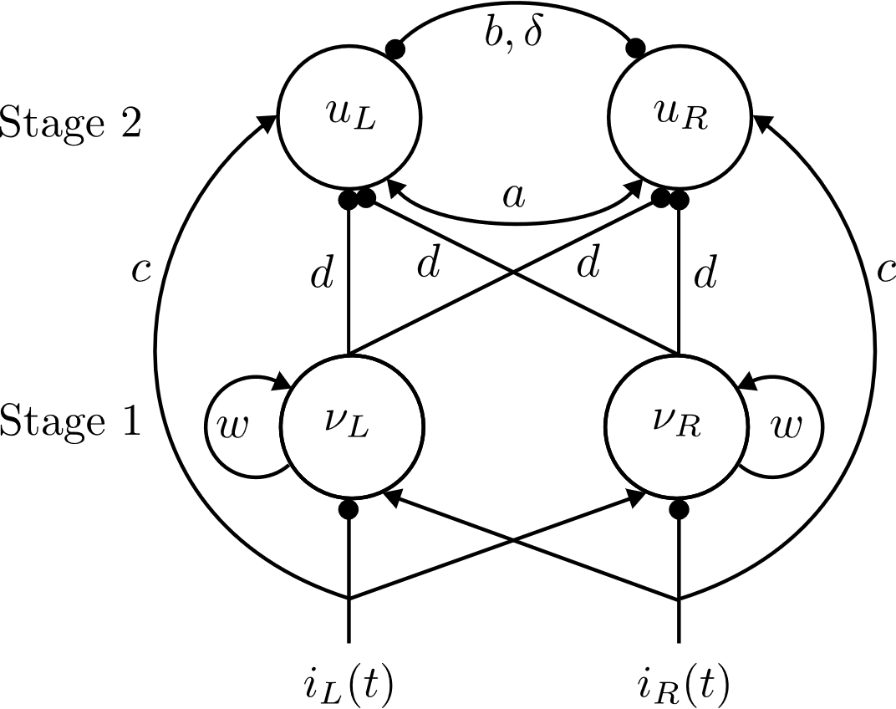
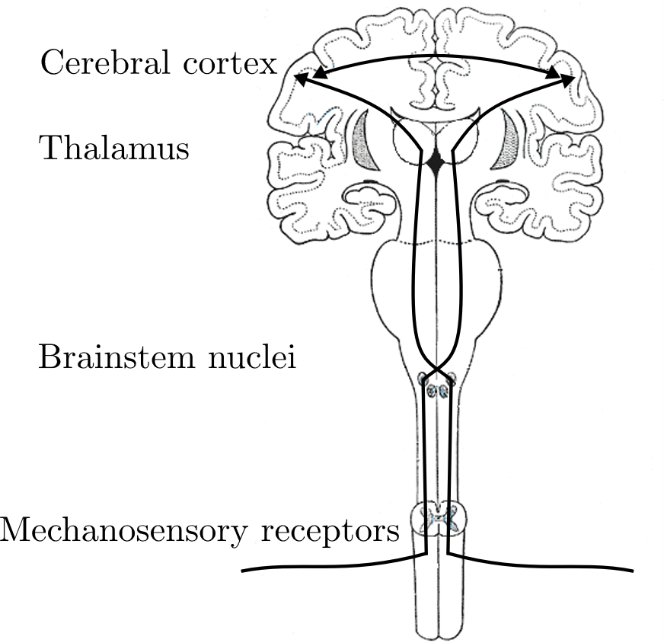
Model of tactile rivalry
1
1
Stage2
0
.
5
0
.
5
0
0
0
1
0
1
1
1
0
.
5
0
.
5
0
0
Stage1
0
1
0
1
Perceptual alternation between the SIM and AM percepts are seen as transitions between DOWN and UP states occur in the inhibitory inputs.
1
1
0
.
5
0
.
5
0
0
0
1
0
1
Darki et al 2022, Biorxiv 2022.08.16.504072
2/3
Notes:
The model I presented in ch5 for tactile rivalry includes two stages, units in the first stage are recurrent self adapt models, the bifurcation diagram for one of these units showed here. By tuning recurrent excitation we can have bistability for intermediate values of input strength.
In the second stage we have two competing units connected through fast excitation and slow delayed inhibitions. Bifurcation analysis with periodic forcing for these units show for excitation strength equal to 2.5 we have direct transition on periodic branch corresponding to SIM and AM percepts. Higher level of excitation move this boundary up and lower excitation move the boundary down. Make it possible to get AM percept except for very low intensity differences.
As the second stage inhibited by first stage, and first stage oscillates between up and down states; this boundary can move to the left and right.
So for the full model, as bifurcation analysis show for a simplified two stage model shows, there exist a region of bistability between the two percepts for some range of input strength. And as time histories shows, when the model also driven by noise, there are oscillations in the first units, which lead to perceptual switches in the second stage.
To have mean dominance durations at different intensity difference compatible with the experimental results, we estimated some parameters, including the parameters of noise, adaptation time constant and nonlinearity in the input through a genetic algorithm with a cost function.
We also showed other things such as the distributions of mean dominance durations are also compatible with experimental results.

Slide 4
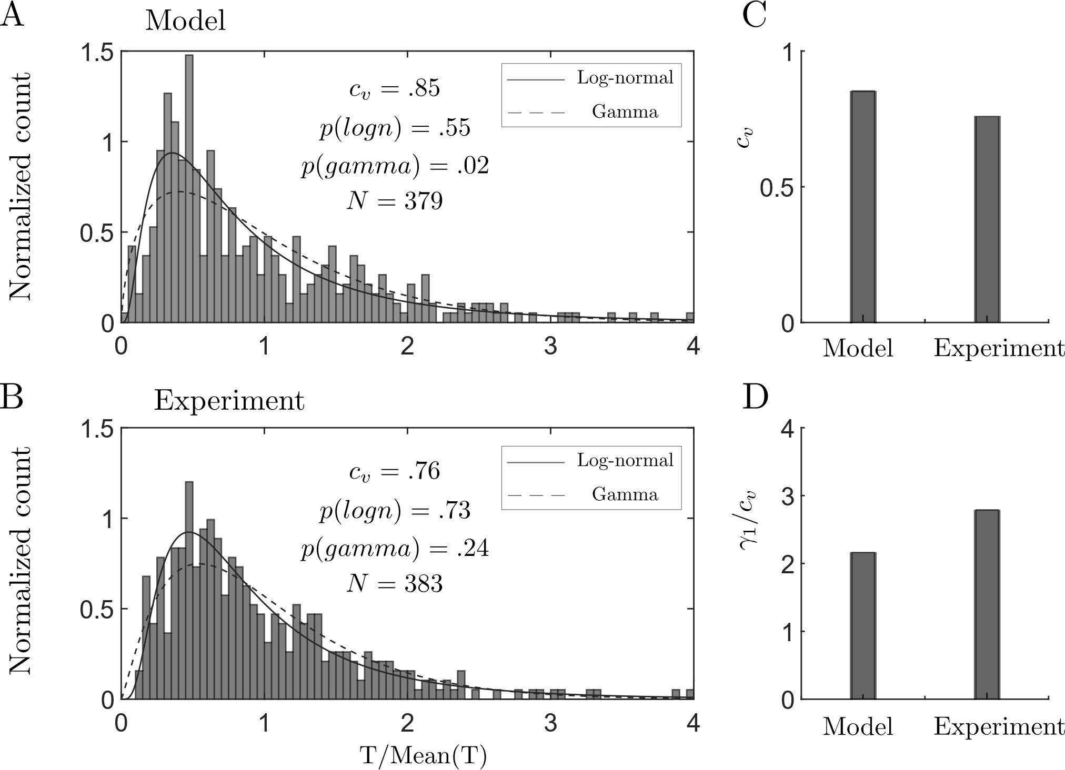
Model of tactile rivalry
Stimulus parameter dependence
Levelt's proposition II
The parameters of the noise, time constant of adaptation, and values of nonlinear function at the experimental conditions were determined using a genetic algorithm.
4
3
2
Variability of perceptual durations
The results from tactile rivalry model best fit by a log-normal distribution.
The ratio of skewness and coefficient of variation for the model are comparable to experimental values.
3/3
Notes:
The model I presented in ch5 for tactile rivalry includes two stages, units in the first stage are recurrent self adapt models, the bifurcation diagram for one of these units showed here. By tuning recurrent excitation we can have bistability for intermediate values of input strength.
In the second stage we have two competing units connected through fast excitation and slow delayed inhibitions. Bifurcation analysis with periodic forcing for these units show for excitation strength equal to 2.5 we have direct transition on periodic branch corresponding to SIM and AM percepts. Higher level of excitation move this boundary up and lower excitation move the boundary down. Make it possible to get AM percept except for very low intensity differences.
As the second stage inhibited by first stage, and first stage oscillates between up and down states; this boundary can move to the left and right.
So for the full model, as bifurcation analysis show for a simplified two stage model shows, there exist a region of bistability between the two percepts for some range of input strength. And as time histories shows, when the model also driven by noise, there are oscillations in the first units, which lead to perceptual switches in the second stage.
To have mean dominance durations at different intensity difference compatible with the experimental results, we estimated some parameters, including the parameters of noise, adaptation time constant and nonlinearity in the input through a genetic algorithm with a cost function.
We also showed other things such as the distributions of mean dominance durations are also compatible with experimental results.

Slide 5


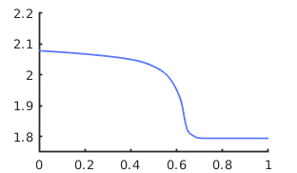
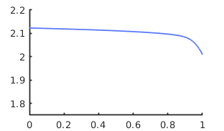
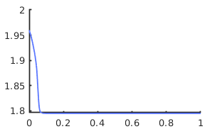
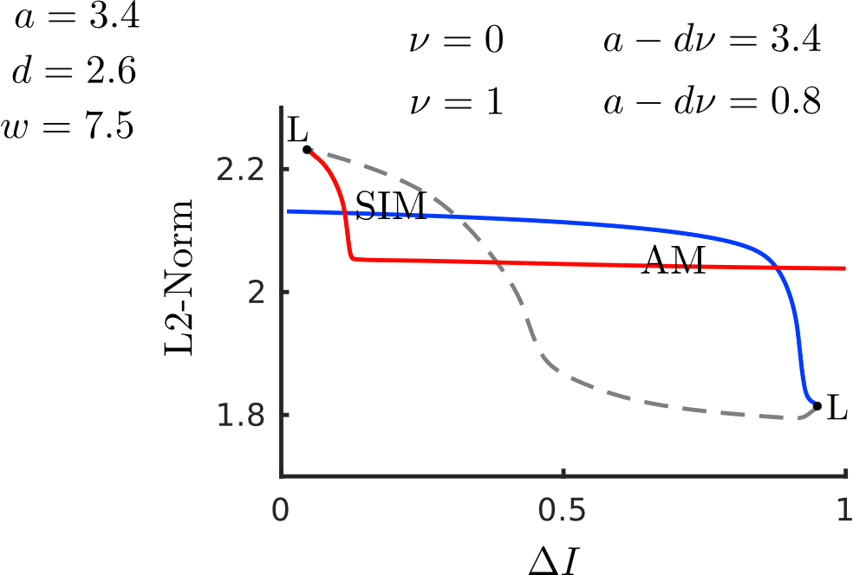
Bifurcation analysis
1
8
0
7
.
5
6
0
5
0
1
2
3
4
5
4
1
3
0
2
.
5
1
0
0
0
1
2
3
4
5
0
1
2
3
4
5
3/3
Notes:
The model I presented in ch5 for tactile rivalry includes two stages, units in the first stage are recurrent self adapt models, the bifurcation diagram for one of these units showed here. By tuning recurrent excitation we can have bistability for intermediate values of input strength.
In the second stage we have two competing units connected through fast excitation and slow delayed inhibitions. Bifurcation analysis with periodic forcing for these units show for excitation strength equal to 2.5 we have direct transition on periodic branch corresponding to SIM and AM percepts. Higher level of excitation move this boundary up and lower excitation move the boundary down. Make it possible to get AM percept except for very low intensity differences.
As the second stage inhibited by first stage, and first stage oscillates between up and down states; this boundary can move to the left and right.
So for the full model, as bifurcation analysis show for a simplified two stage model shows, there exist a region of bistability between the two percepts for some range of input strength. And as time histories shows, when the model also driven by noise, there are oscillations in the first units, which lead to perceptual switches in the second stage.
To have mean dominance durations at different intensity difference compatible with the experimental results, we estimated some parameters, including the parameters of noise, adaptation time constant and nonlinearity in the input through a genetic algorithm with a cost function.
We also showed other things such as the distributions of mean dominance durations are also compatible with experimental results.

